Slide 1
Collaboration and Growth of Open Source Enterprise Computing with Open Mainframe Project

Slide 2
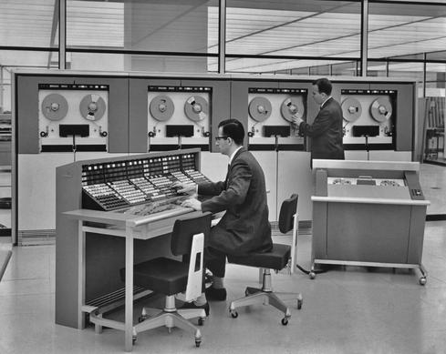
Not this mainframe…

Slide 3
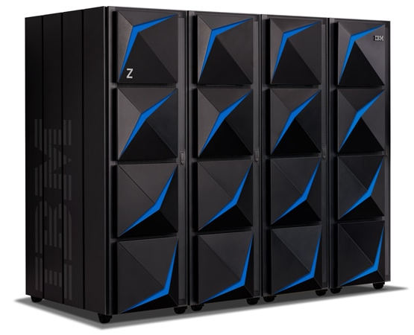
The modern mainframe ( IBM z15 )
Up to 190, 10 core 5.2ghz processors ( read more at https://en.wikipedia.org/wiki/IBM_z14_(microprocessor) )
Up to 40TB of RAIM (random array of independent memory)
Heavy optimization for i/o bound workloads
Hardware based encryption
Fault tolerant, native hot swapping of hardware components ( z stands for zero downtime )
And….runs Linux and Open Source!

Slide 4

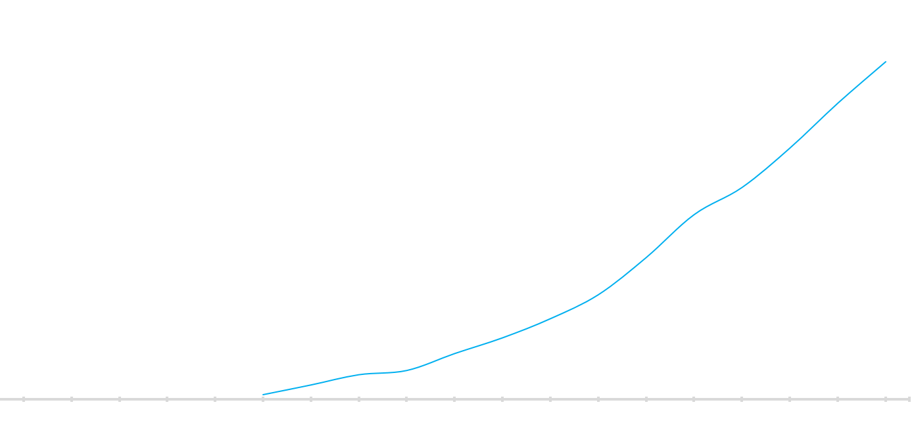






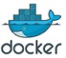

Open Source on the Mainframe - A Journey of Innovation and Technology
2017:
IBM z14
z/VM Subcapacity
IBM Wave 1.2 SP6
2016:
KVM 1.1.2
z/VM 6.4
2015:
KVM for IBM z
IBM Wave upd.
IBM zAware for Linux
IBM LinuxONE™
IBM Cloud Private
Db2 Warehouse
DBaaS ref.archit.
Spectrum Scale 5.0
Docker Ent.Edition
Blockchain
Open source ecosystem
2014:
IBM Wave
OpenStack
Db2 BLU
GDPS® Virtual Appliance
Financial Transaction Mgr
Open source ecosystem
2009:
z/VM v6
Enterprise Linux Server (ELS)
RHEL 7.3
SLES12 SP2
Ubuntu 16.04
KVM support distros
RHEL 7.4
SLES 12 SP3
Ubuntu 17.04
First release
2000:
SUSE Linux
2001:
Red Hat Linux
Spectrum Scale™
Oracle 12c
1999:
Linux on S/390®
2001: HiperSockets™
2007:
IBM Big Green Consolidation 3900 to 30 servers
RHEL 7.2
SLES 12 SP1
2000:
Integrated Facility for Linux (IFL)
2013:
>3000 Applications
2015:
Open Mainframe Project
2006:
1000 Appl., 300 ISVs
Shipped Linux capacity
(in MIPS)
1999: IBM Linux Tech Center
2000:
Db2®, WebSphere®
2002:
major ISVs:
SAP, Oracle 9i
Notes:
Here a rough overview on the innovation and evolvement.
All started with the first commercial distribution in 2000, and since then the Linux on IBM Z shows a constantly growing capacity over the last 18 years. IBM invested and invests a lot in the evolvement of the necessary components: the Linux development for Z, the Z hardware and Z virtualization technologies, as well in IBM software products. Some major ISV products (SAP, Oracle, Docker) are shows as well, and the Linux distributions offered by our Linux partners.
And as you can expect, this story goes on!
FYI:
The data includes Z and LinuxONE servers; the majority of the Linux capacity is running on Z servers.
All virtualization, IBM, ISV and opens source products run on Z and LinuxONE servers – no difference even some material mentions only one environment.

Slide 5






How does mainframe impact me?
Banking | Insurance | Healthcare
Government | Transportation | Retail

Slide 6
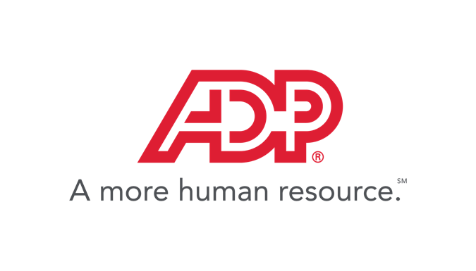
Pays 1 in 6 U.S. workers
Pays 1 in 4 Canadian workers
Processed nearly 53 million W-2’s in 2014
…all thanks to mainframe!
Notes:
8000 VM of Linux running in their infra

Slide 7
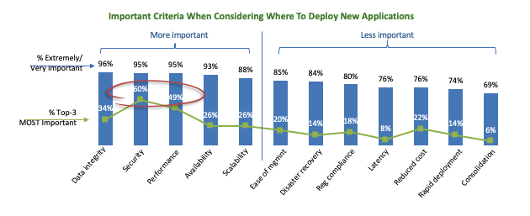
Mainframes are here today and will be tomorrow
Mainframe’s strengths align with enterprise needs of today
Source: Open Mainframe Project Market Survey, Summer 2018

Slide 8
Why a Foundation?

Slide 9
Open Source on Mainframe roots
1955
SHARE established Historical root of open source movement
1999
Linux ported to s390x by community effort from Marist University and other enthusiasts
2001
Major Linux Distros support mainframe Initially SUSE, but followed by Red Hat and others
2001
Major Linux Distros support mainframe Initially SUSE, but followed by Red Hat and others
2013
Open Source ecosystem hits critical mass OpenStack, KVM, PostgreSQL supported on s390x

Slide 10





Open Source on Mainframe challenges
Disconnected, independent efforts; no shared “hub” of innovation
Community events are industry specific, not vendor agnostic
Open source on the mainframe lacks a neutral home for growth
No place for students and academic institutions to engage
Enterprise level
engagement with
upstream projects limited
Notes:
Many users, many developers, many vendors but almost all are working independently or in small groups to improve open source on the mainframe. There was no open “hub” for intersecting together.
Open source software is built in a “scratch your own itch” model, but unless improvements are shared within a community, the benefits are not realized by the community.
Coordinating Enterprise Grade improvements to upstream projects is limited today and could improve the quality of improvements and ease of getting them accepted upstream.
Events, meetings and attempts to coordinate are often led by individual vendors and are often industry specific, lack a community driven purpose, organic interest or are not designed to help the collective community.
Academic institutions are looking for ways to get their students practical experience to prepare for employment with large Enterprises; clients are looking for skills to employ.
Open Source communities prosper when there is a neutral home for collaboration, built under rules that encourage participation and sharing, and are designed for the purpose of building technology that the community wants to invest collectively to build together. There are many opportunities for leveraging an open source community focused on the needs of Enterprise Grade environments.

Slide 11




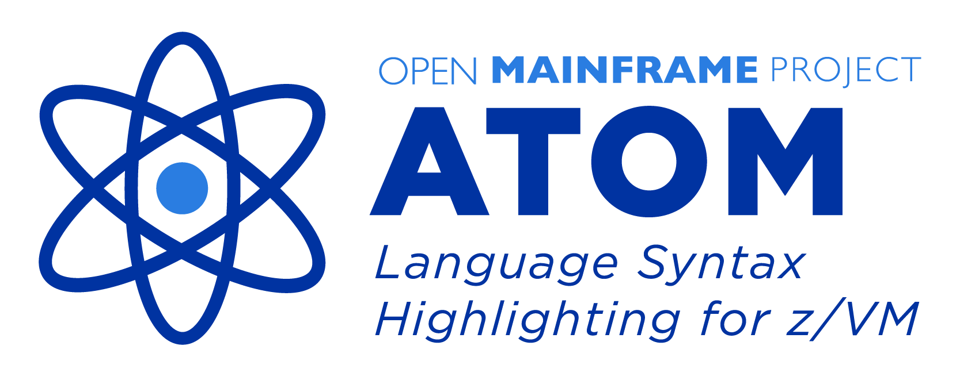
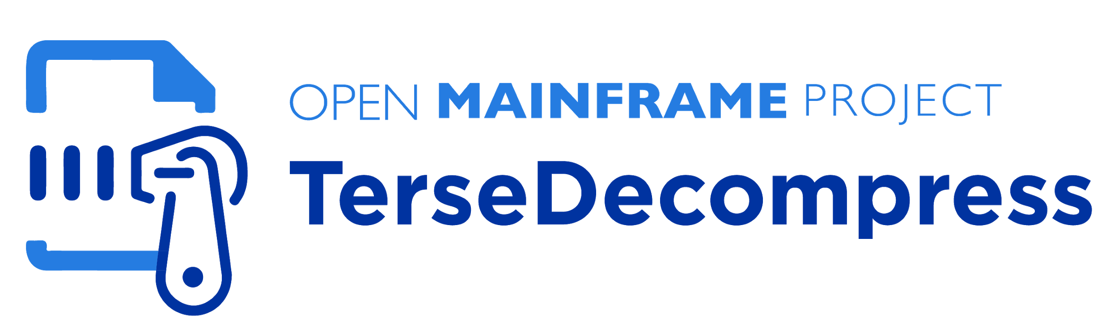
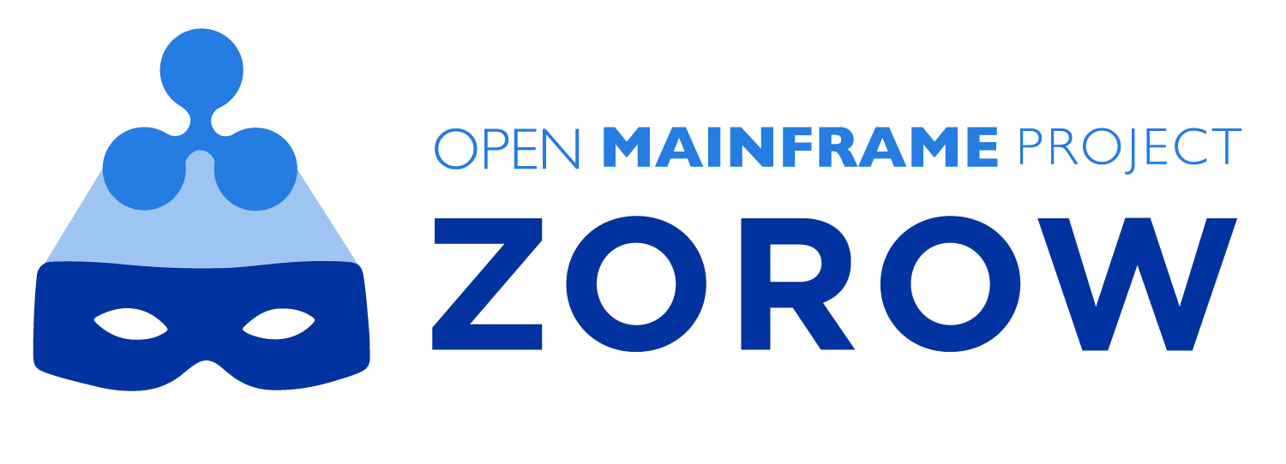
Open Source on Mainframe innovation accelerates under Open Mainframe Project
2015
Open Mainframe Project launched at LinuxCon Seattle, along with LinuxONE and IBM contributions of seed code for ADE
2016
First summer interns port Alpine Linux, contribute to open source tooling.
2017
Doubling of membership with 8 new academic partners and other industry members
2018
Zowe launched First ever open source project launched on z/OS
2019
Doubling of hosted projects with launch of Feilong, TerseDecompress and Zorow

Slide 12




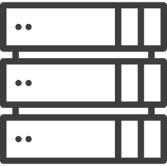

Mainframe is key part of Open Source success
100%
82%
2nd
90%
90%
62%
#1
Supercomputer Market
Smartphone Market Share
To Windows in Enterprise
Mainframe Customers
Public Cloud Workload
Embedded Systems Market
Internet Client
Every market Linux has entered it eventually dominates

Slide 13
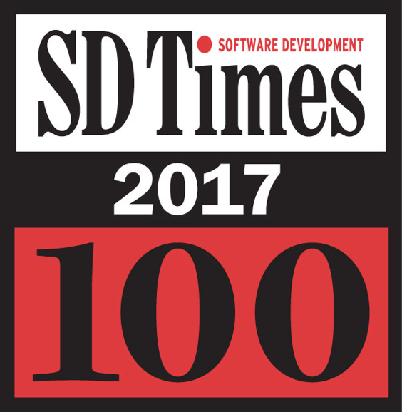
Why a Foundation? Open Ecosystems are Critical to Us All
“It’s one thing to create a great piece of software. It’s quite another to have it make a mark on the entire industry. These are the companies and organizations whose work has had a significant impact on what others build, how they build it, and ultimately, who uses it.”
SD Times Influencers: Apple, Facebook, Google, IBM, Intel, Microsoft, GitHub, Netflix, Red Hat, Slack, The Linux Foundation

Slide 14


The Linux Foundation focuses on creating innovation engines
PROJECTS
Successful projects depend on members, developers, standards and infrastructure to develop products that the market will adopt
DEVELOPER
COMMUNITY
TECHNOLOGY
PARTICIPATION
MARKETS
PRODUCTS
PROFITS
PRODUCTS

Slide 15




Foundations enable the gears of innovation to spin faster
Projects
Value
Solutions

Slide 16
One Developer at a Time and One Industry at a Time

Slide 17
Mission of the Open Mainframe Project:
Build community and adoption of Open Source on the mainframe
Eliminating barriers to Open Source adoption on the mainframe
Demonstrating value of the mainframe on technical and business levels
Strengthening collaboration points and resources for the community to thrive

Slide 18
Eliminating barriers to Open Source adoption on the mainframe
Engaged as central expert in demonstrating the mainframe as a viable open source platform, with compelling advantage.
Promotion of modern application and workload examples on the mainframe
Growing career opportunities and academic community engagement
Hosting and participating in local programming and promotion of Open Source on the mainframe
Sponsorship of global initiatives and contests to grow enthusiasm for the platform

Slide 19
Demonstrating value of the mainframe on technical and business levels
Showcase of technical and business case studies through blogs, white papers, and other media.
Champion software and hardware solutions with clients

Slide 20
Strengthening collaboration points and resources for the community to thrive
Engagement through Technical Steering Committee projects and independent projects by members
Visibility to tools, resources, and community forums to tackle technical challenges
Career opportunities from internships through retirement

Slide 21
How does the project do this?

Slide 22
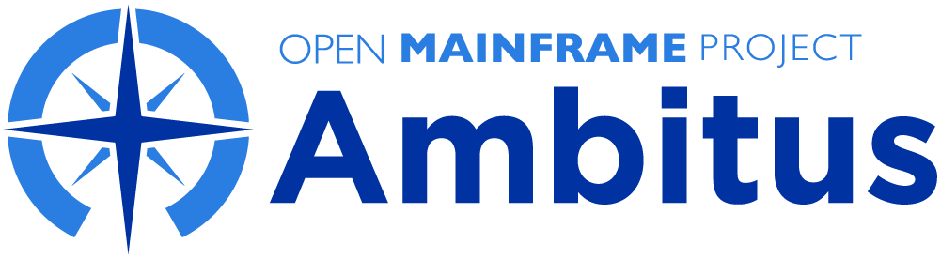


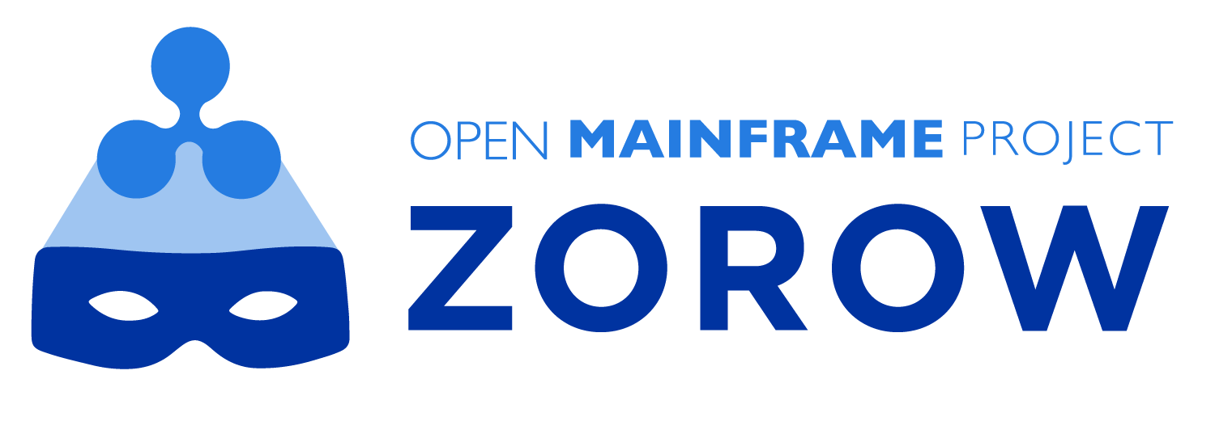

Creating spaces for mainframe community open source collaboration
Learn about all Open Mainframe projects at https://www.openmainframeproject.org/projects

Slide 23
Connecting z/OS to enterprise devops with Zowe
Zowe is an extensible framework for connecting applications and tools to z/OS mainframe data and applications.
It’s aim is to make the z/OS mainframe an integrated and agile platform within the changing IT architectural landscape.
Zowe is the first open source project launched on z/OS. All code is licensed under the Eclipse Public License version 2.0

Slide 24
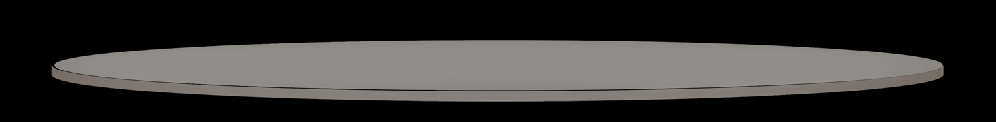
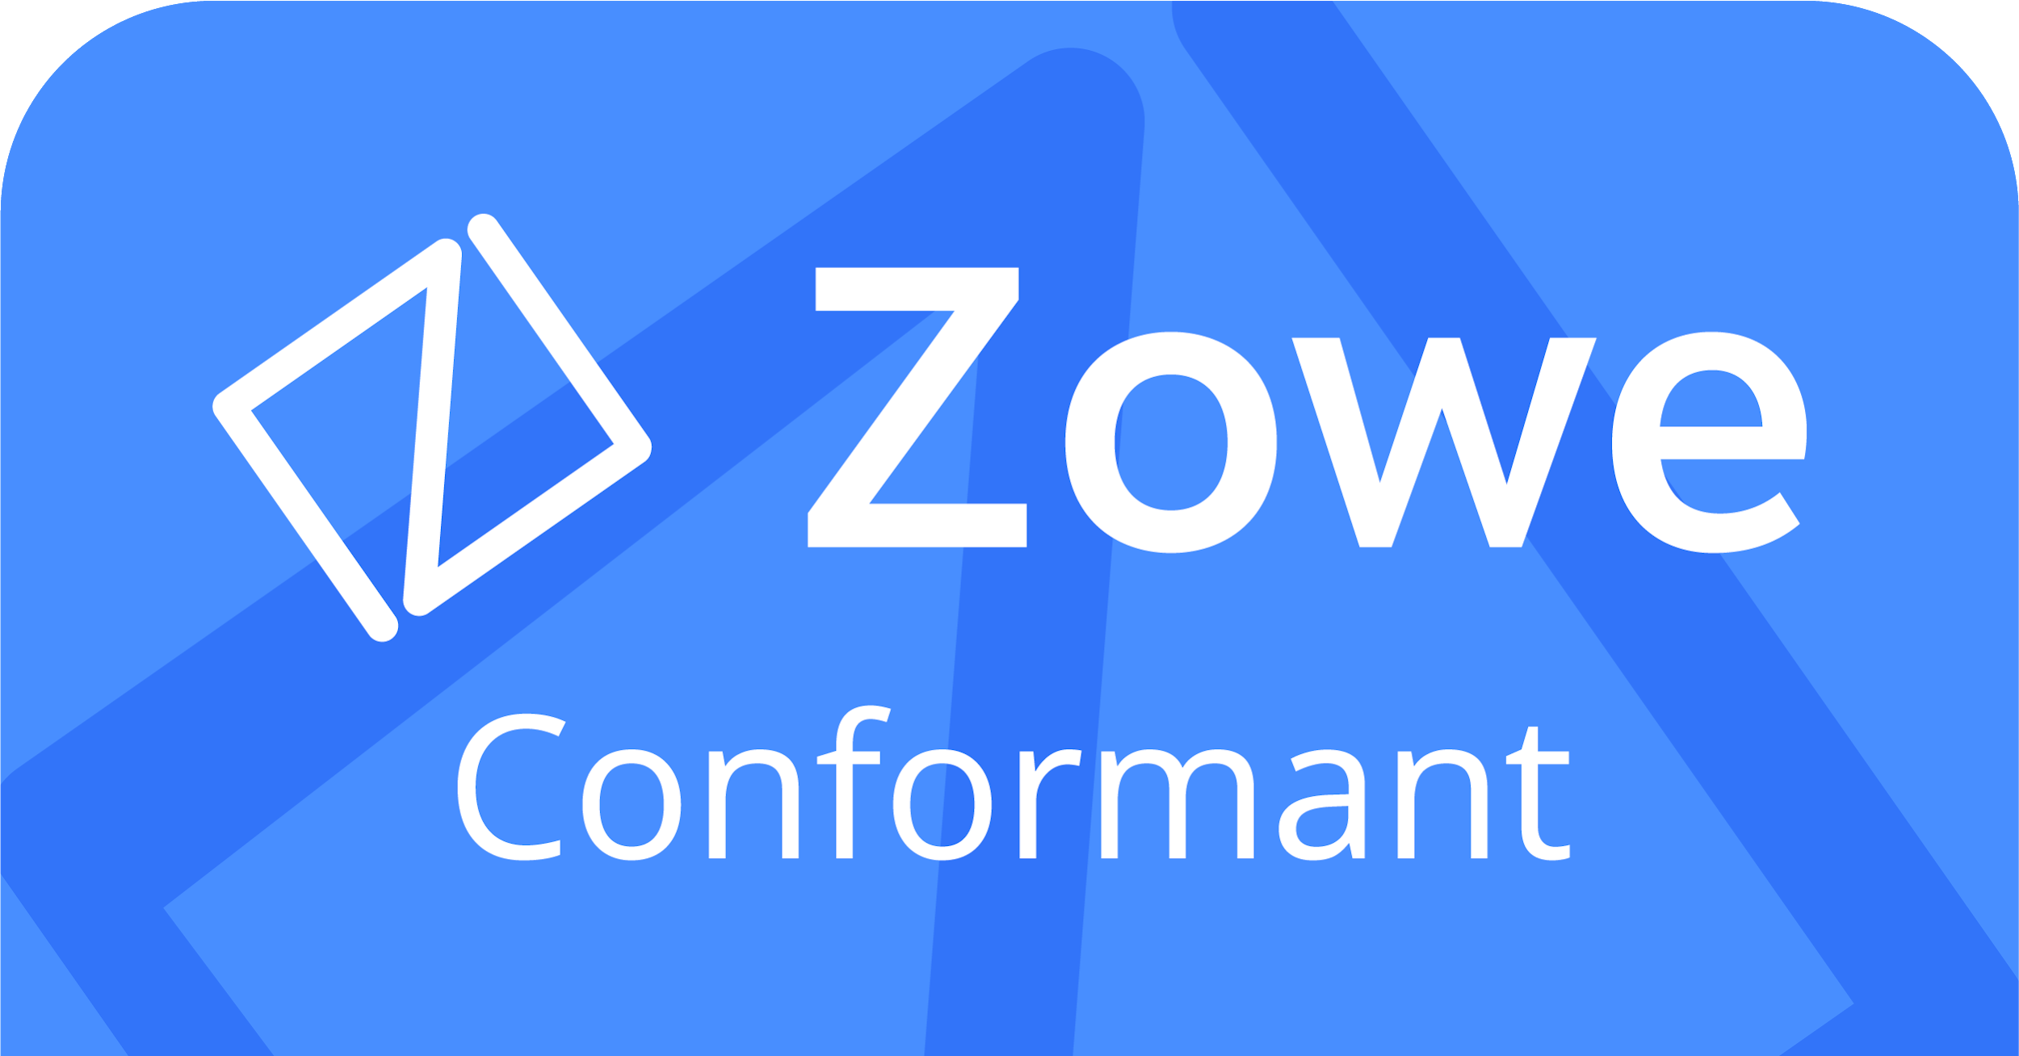
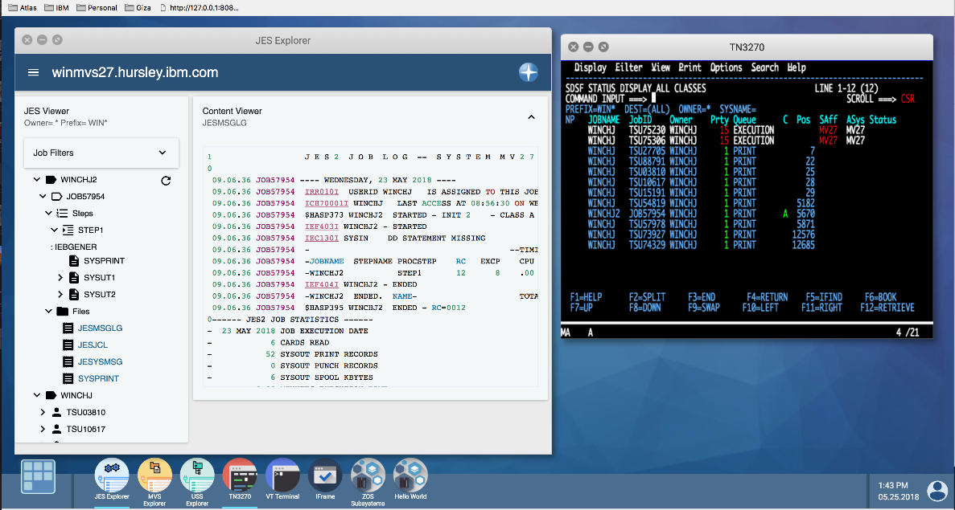
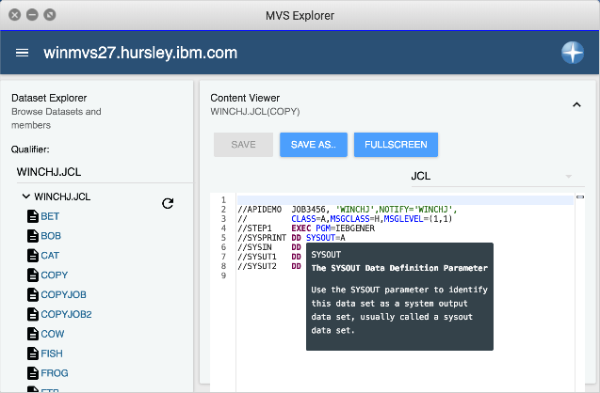

Zowe framework and ecosystem at a glance
Microservices
API Mediation Layer
CLI
App Framework
Plugins
CODE
DEPLOY
Plugins
PLAN
Plugins
BUILD
RELEASE
OPERATE
Plugins
TEST
MONITOR
Plugins
Plugins
Notes:
What this slide will communicate:
Zowe framework
What is Zoe? How do we see the organization and project develop over time?
What are the architectural design considerations and standards?
What are the initial core technologies/IP? Show the Stack. Show a roadmap
What is each founding member bringing to the table?
What is the take-away from this slide?
The initial contributors IBM, CA, and Rocket as the initial contributors members are committed to investing/extending core technologies and standards to move this project forward. We also are committed to aligning our future product portfolio development for the mainframe to adopt this open framework. The Zowe framework offers industry standard REST APIs, API Mediation Layer, an extensible command line interface and an extensible Web-based UI framework and motif.

Slide 25
Driving the next gen of tools connect cloud tools to mainframe through Feilong
Users want to manage their mainframes with the same modern cloud technologies used across the enterprise.
z/VM integration with technologies such as OpenStack have long been a challenge.
Feilong is the vendor-neutral project that extends from z/VM Cloud Connector to enable a broad community to build this technology out further.
Initial contributing organizations include IBM and SUSE.
More details at https://github.com/openmainframeproject/python-zvm-sdk

Slide 26
Zorow enables user collaboration on z/OSMF workflows
z/OSMF workflows are often common across mainframe users
Yet sharing patterns and best practices is ot often possible due to licensing.
Zorow project provides a vendor-neutral forum for sharing z/OSMF workflows.
Initial contributors include IBM and Rabobank
Learn more at https://github.com/openmainframeproject/zorow

Slide 27
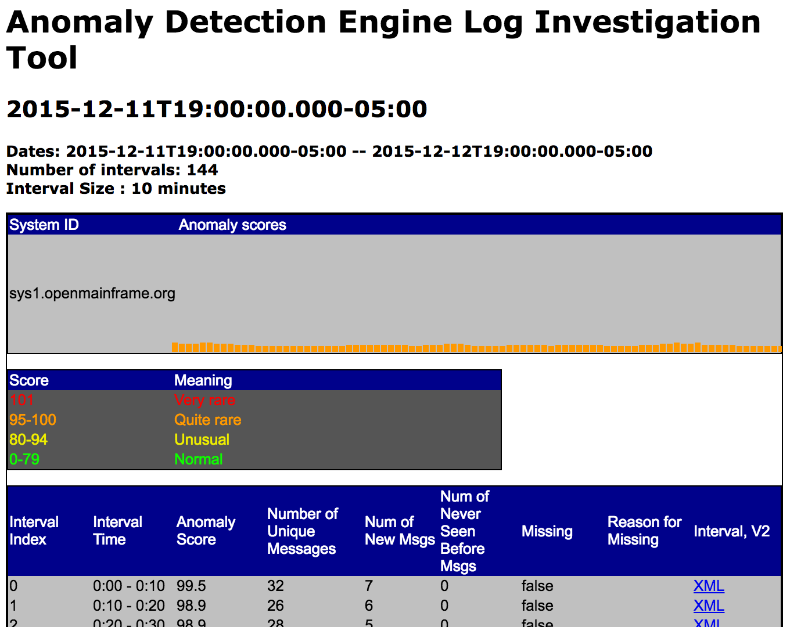
ADE: Bringing mainframe innovation to Open Source
Anomaly detection Engine for Linux Logs (ADE) project brings innovation that has long been on the mainframe to the larger Linux world
ADE detects anomalous time slices and messages in Linux logs (either RFC3164 or RFC5424 format) using statistical learning.
Learn more at http://openmainframeproject.github.io/ade/

Slide 28
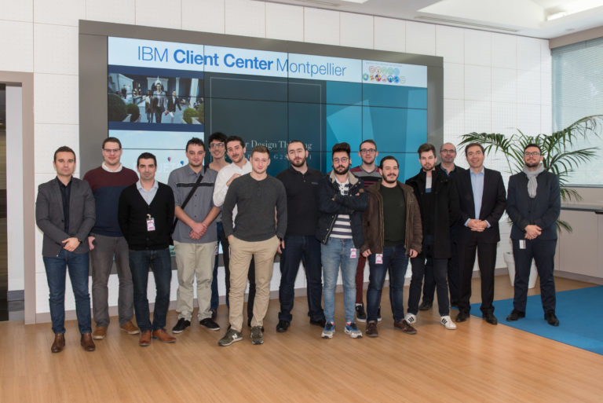
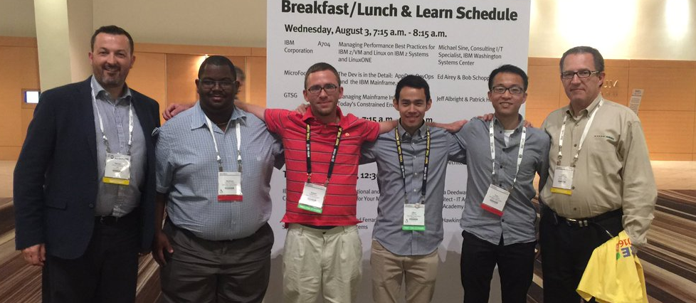
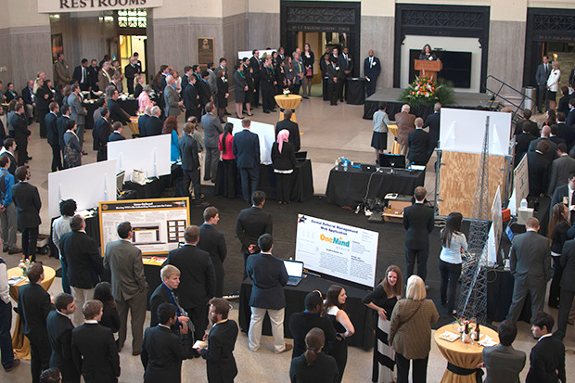
Mentorship and academic engagement programs are putting mainframe in the hands of the next generation
Blockchain Hackathon for EPSI University in France
Summer Internship Program
36 Mentees sponsored | 14 Supporting academic institutions | 100+ Students impacted
VCU Capstone Partnership

Slide 29
Open Mainframe innovation thrives here
OMP provides a vendor-neutral home for mainframe-centric open source projects
Code hosting/infrastructure
Governance
Legal/Trademark defense
Ecosystem development
LF staff support project communities establishing guidelines and best practices to enable diverse community growth and adoption
Our philosophy creates natural collaboration opportunities between mainframe-centric open source projects
Project lifecycle, guidance, and proposal process openly defined at https://github.com/openmainframeproject/tsc/tree/master/process

Slide 30
Supporting open source on mainframe beyond hosted projects

Slide 31





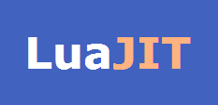





Sustained mainframe support in the broad open source community through the Supported Projects program
Infrastructure | Developer support | Market awareness | Governance/IP Home
Participating Open Source Projects include

Slide 32
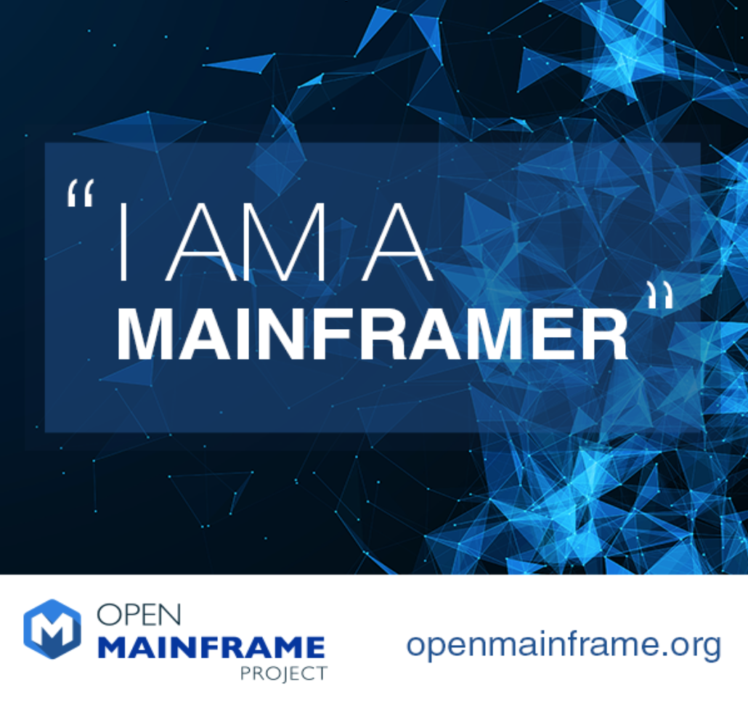
Telling the “mainframer” story
Monthly interview series that highlights both new and old in mainframe
Goal is to showcase why people have mainframe in their careers and their views of the technology and career field
Read and listen at https://www.openmainframeproject.org/category/blog/i-am-a-mainframer

Slide 33

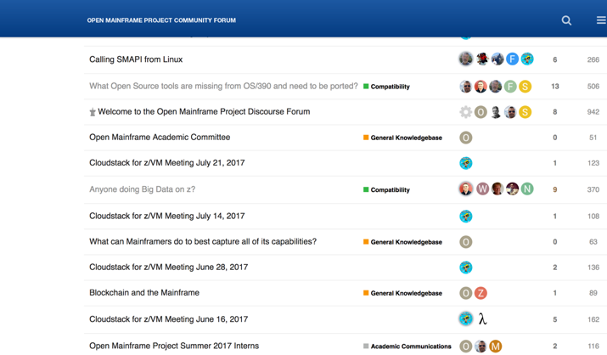
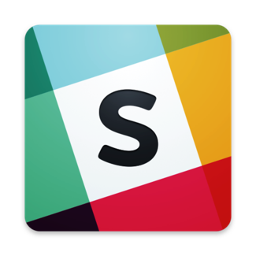
Bringing together the open source and mainframe conversation
Sponsored Meetup Program
https://www.openmainframeproject.org/meetup-program
Community Forums
https://community.openmainframeproject.org/
Slack Channel
https://slack.openmainframeproject.org

Slide 34

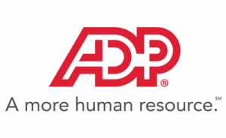

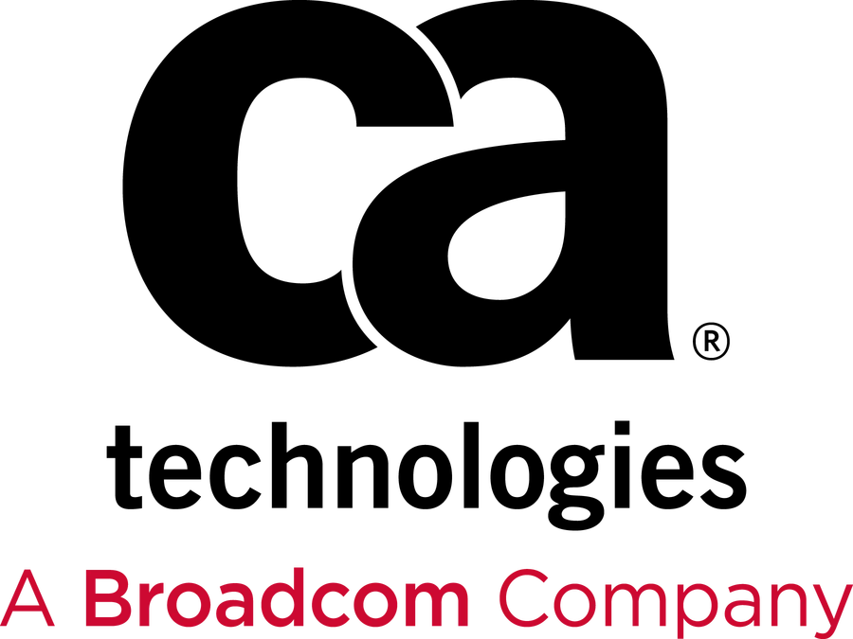



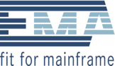

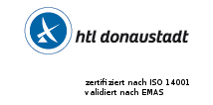





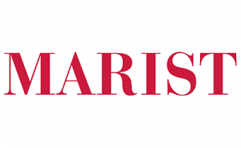
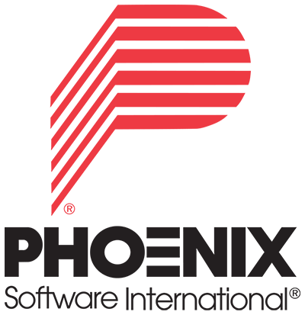

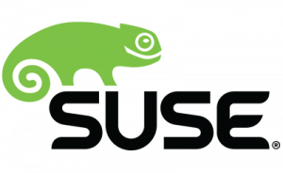






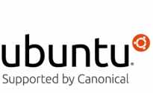

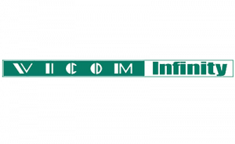



Open Mainframe Project Momentum
4 years since launch | 33 Supporting Organizations | 8 Hosted Projects | 36 Mentees Sponsored | 100+ Students Impacted | 200+ Project Contributors
Zoss Team, LLC

Slide 35
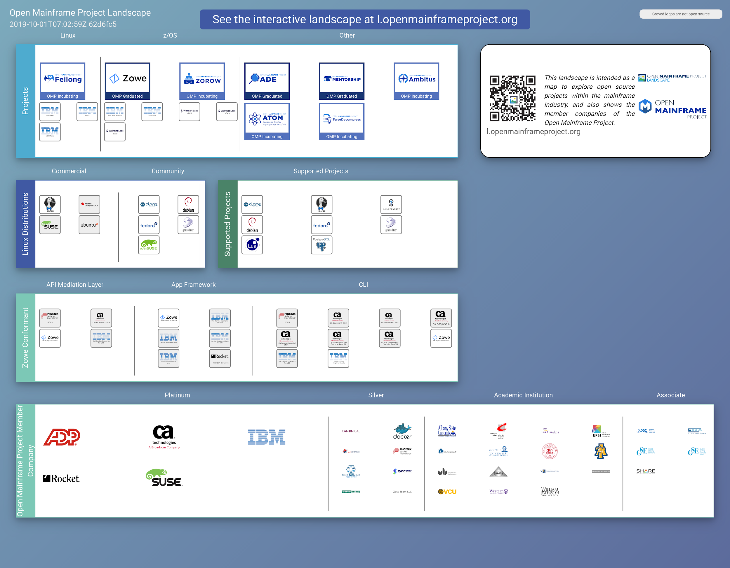
Open Mainframe Project Landscape
https://landscape.openmainframeproject.org

Slide 36

How to participate in Open Mainframe Project
Open participation for all interested in Mainframe and Open Source
Community discussion and collaboration - both virtually and at regional events.
7 Shared R&D open source projects - or bring your project to be hosted here
Corporate sponsorship for showing stewardship in the community
‹#›
Notes:
Anyone may participate; the Open Mainframe Project will encourage companies to become sponsoring participants and support the mission of the Open Mainframe Project with resources
Corporate participation levels include Platinum, Platinum End-User, Silver, Academic and Associate Entity levels.
A Technical Steering Committee will focus on overseeing the technical community
Approves new Open Mainframe Project projects, sets development process guidelines for the community, sets release guidelines, oversees technical collaboration with upstream projects, etc.
The initial TSC will be bootstrapped with representatives from the Platinum and Platinum End-User level participants with the goal of adding projects with Maintainers to the TSC.
Anyone can contribute, become a project committer or maintainer and thereby serve on the TSC based on the success and quality of their contributions as recognized by peers.
A Governing Board will oversee business decision making
Composed of Platinum-level participant appointees, elected Silver representatives, elected Academic Institution representatives, and the TSC Chair.
The Governing Board will address the business needs associated with budgeting, planning for any large meetings (e.g. a Summit), marketing (if any), whether to run a “summer of code” internship, etc.

Slide 37


Learn more about the Open Mainframe Project
Find out more and subscribe to our newsletter at www.openmainframeproject.org
Organizational membership opportunities at https://www.openmainframeproject.org/about/join or email at membership@openmainframeproject.com
Talk to me after this talk!

Slide 38
Questions?

Slide 39
Thank you!

Slide 40
Membership

Slide 41
Membership Benefits (1)
Industry Leadership
Shape the Open Source Mainframe market
Network with other members of Open Mainframe Project
Participate in Open Mainframe Project event and speaking opportunities
Join Open Mainframe Project Projects
Serve on the the Governing Board to help shape investments of Linux and Open Source on Mainframe (Platinum only)
Marketing Opportunities
Benefit from and participate in Open Mainframe Project marketing efforts
Engage with your peers on the marketing committee
Feature your products and applications that leverage Linux and Open Source on Mainframe at key industry events, website and marketing collateral
Use Open Mainframe Project branding assets in promotion of your product

Slide 42
Membership Benefits (2)
Technology Leadership
Contribute to and influence the direction of Open Mainframe Project technical investments
Drive leadership for future enhancements and extensions that matter for your business
Ability to guide feature sets in requirements documents and future technology roadmaps
Support and drive community work by being a voting member of the Technical Steering Committee (Platinum only)
Learning and Engaging
Engage and collaborate with the membership community to enhance your Open Source/Linux on Mainframe roadmap.
Work together across company lines and industries.
Create products & apps secure in the knowledge that they will be interoperable in across enterprise class architectures.
Ability to serve as an Open Mainframe Project Advocate at events and in the community.

Slide 43
Corporate, Academic, Associate Membership Levels
Level | Annual Fee | Board Seat | TSC Seat | Marketing Committee | Notes
Platinum | $120,000 | Yes | Voting | Yes | Initial 2-year participant commitment
Platinum End-User | $30,000 | Yes | Voting | Yes | Initial 2-year participant commitment
Silver | 5,000 employees or more = $35,000 3,000 < 5,000 employees = $30,000 1,000 < 3,000 employees = $25,000 500 < 1,000 employees = $20,000 100 < 500 employees = $12,000 < 100 employees = $7,000 | 1 per 10 | Non Voting | Yes
Academic | Free | 1 per 10 | Non Voting | Yes | Restricted to academic institutions
Associate | Free | No | Non Voting | Yes | Non-profits, open source projects
To join Open Mainframe Project, go to https://www.openmainframeproject.org/about/join or email at membership@openmainframeproject.com
Listed fees include Linux Foundation Silver membership. If you are already a Linux Foundation Member, reduced pricing is available.
‹#›

